Slide 1
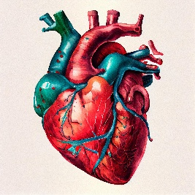
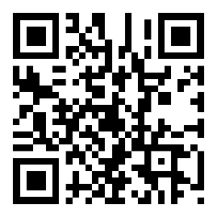
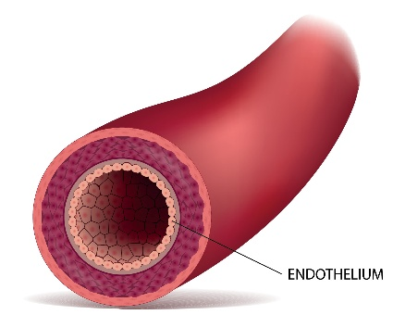
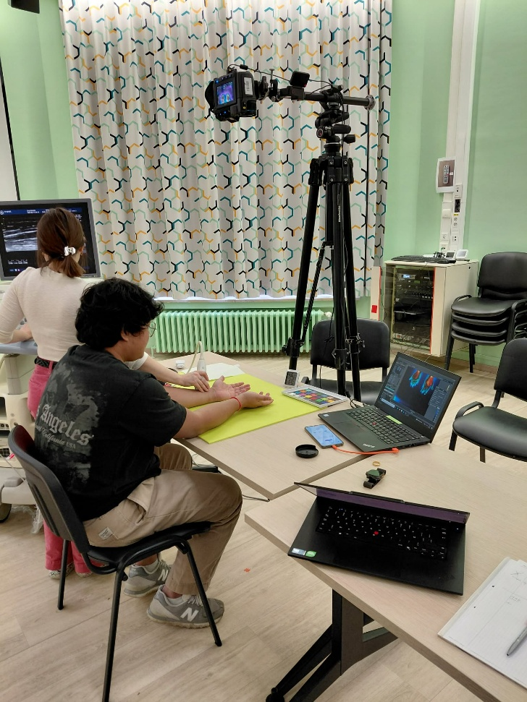


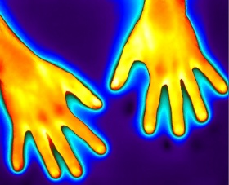
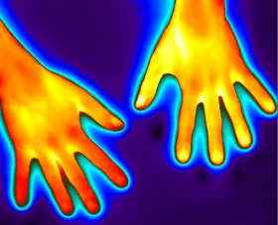
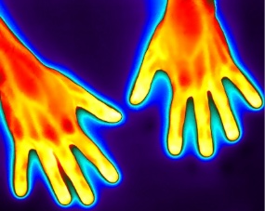
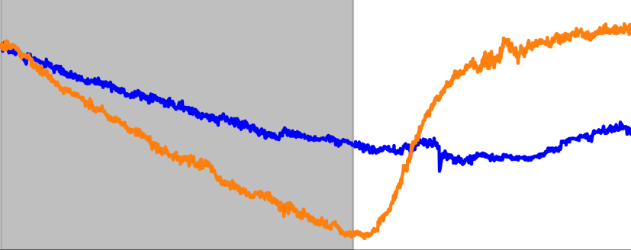
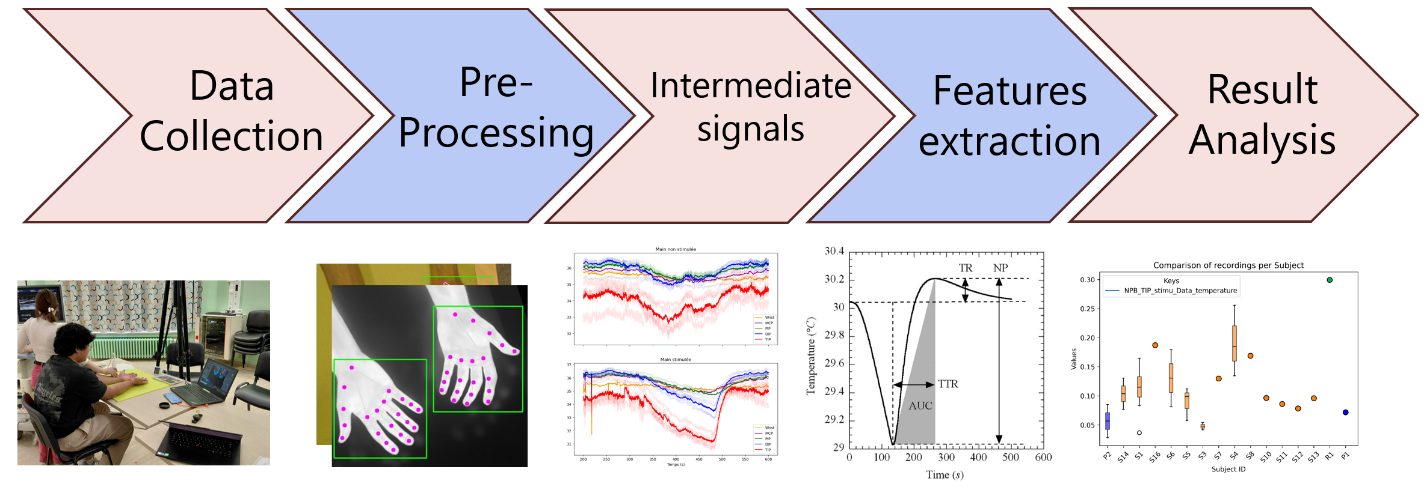
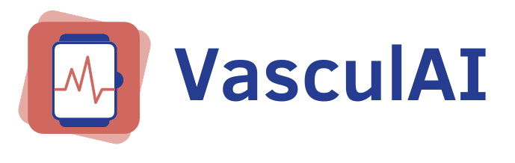

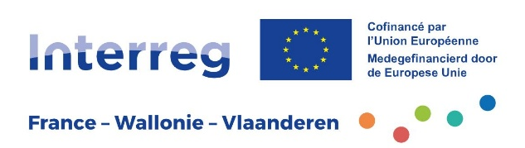




Non-invasive multimodal health assessment
Antoine Collet (Antoine.collet@umons.ac.be) ,
Thierry Dutoit (promotor), Stéphane Carlier (co-promotor)
18 million deaths per year worldwide of cardiovascular disease.
Endothelial dysfunction is an early marker of these diseases.
1. Context
Develop methods to extract novel endothelial biomarkers from thermal video:
Identify reliable endothelial function parameters
Develop tools for clinical use
2. Objectives
3. Reactive hyperemia protocol
Endothelial stimulation protocol induces temperature changes due to vasodilation.
5. Preliminary results
Start recording
End recording
Thermal response differs between healthy and unhealthy subjects
200mmHg
Stabilization (3 min)
Occlusion (3 min)
Recovery (5 min)
Temperature (°C)
4. Pipeline of processing
Occlusion
Post-occlusion
Extract medical parameters from raw data
Time (s)
6. Next Steps
Large data collection & publish dataset
Multimodal approaches
This thesis is part of the VasculAI project, which aims to improve early detection of cardiovascular risk using thermal video, wearable sensors, and artificial intelligence.
Notes:
Aérer les blocs
Ligne directrice des blocs
Texte message titre
Structure, mettre des titres
On doit savoir facilement lire
Courbes, expliciter c’est quoi les 2 couleurs
Peu mettre plus petit
AU lieu de mettre image pour pipeline, mettre explication en texte. Que ce soit compréhensible
Conclusion/perspective ajouter

